Slide 1

​​​​​ព្រះរាជាណាចកម្ពុជា
ជាតិ សាសនា ព្រះមហាក្សត្រ
Topic :The Fashion website
Member
Hout Sokreaksmey
Huot Sophearin
Heng Ratha
Lecturer Name:
Lypengleang Seang

Slide 2
Content
Introduction
Purpose
Scope
Fearture
Technology

Slide 3
Introduction
The Fashion website we are focusing on web development as an alternative for people to get these information and knowledge on online shopping more than from TV... We choose the opportunity that we can provide
The good template to business online. This platform can help heighten their knowledge and enhance their ability to know and understand about the website with laravel.

Slide 4
Purpose
The Fashion that we are create in order to share specific product post on website and to keep in touch with customer who use the Internet almost website.moreover this web site can help customer to purchase product easier than they direct shopping.whatever our website that create owner shop easy to manage and keep monitoring.

Slide 5
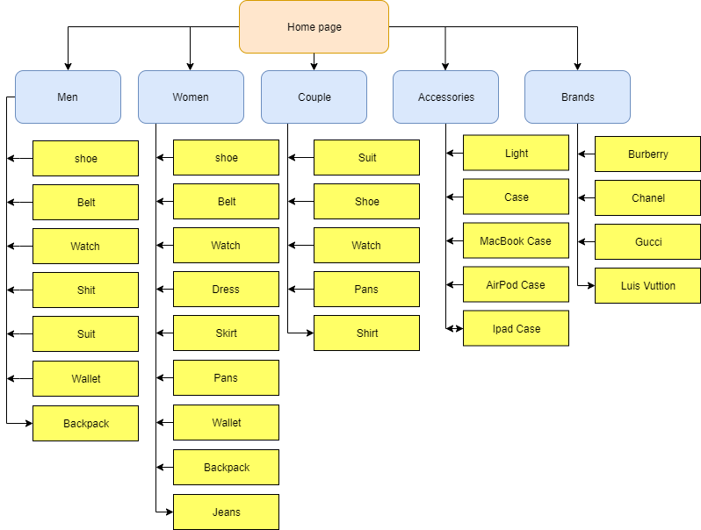
Scope
Site Map front-end

Slide 6
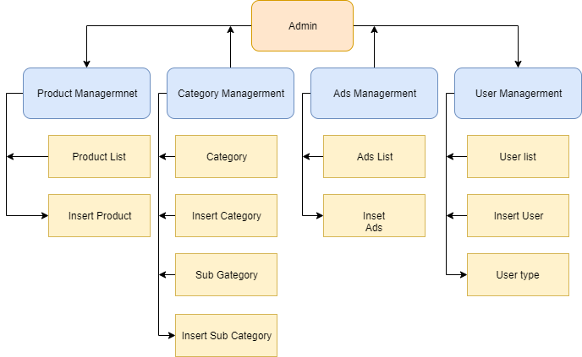
Site Map Back-end

Slide 7
II. Fearture
The The Fashion website we have feature.
Amin
User Login
User Signup
CRUD Products
CRUD Categories
CRUD SubCategory
CRUD Product
CRUD User
2. Client
Can view Product and Category and Sub Category
Search Product by name and code

Slide 8
Technology
PHP Framework (Laravel)
Bootstrap
MySQL
Javascript

Slide 9
Thanks for attentions

